Slide 1
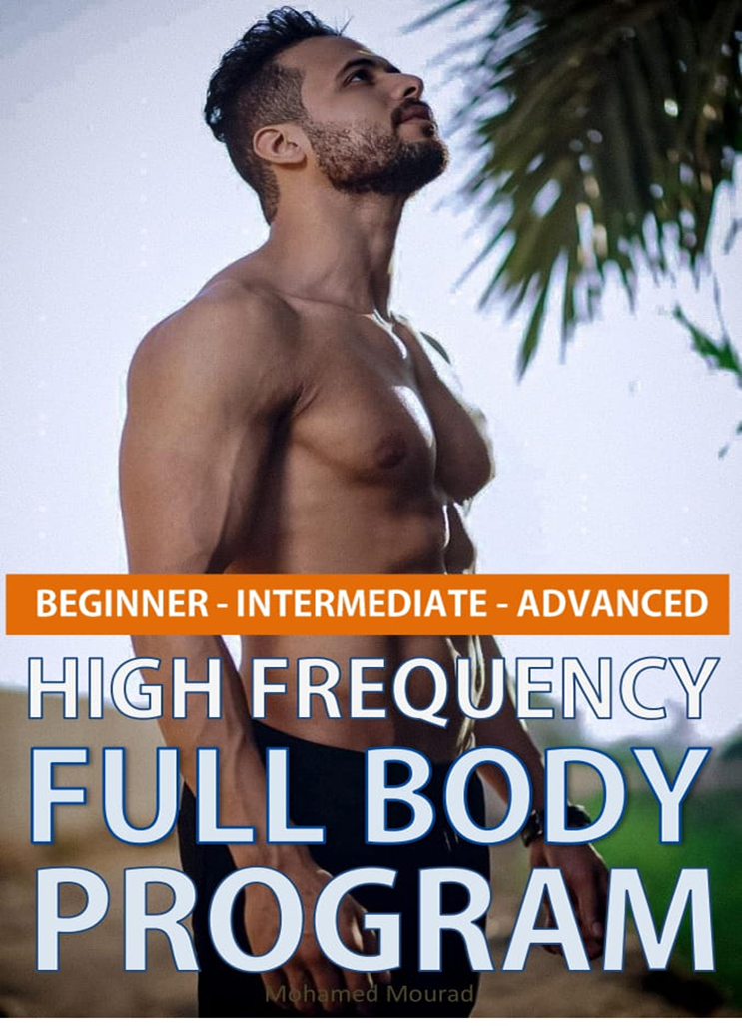

Slide 3
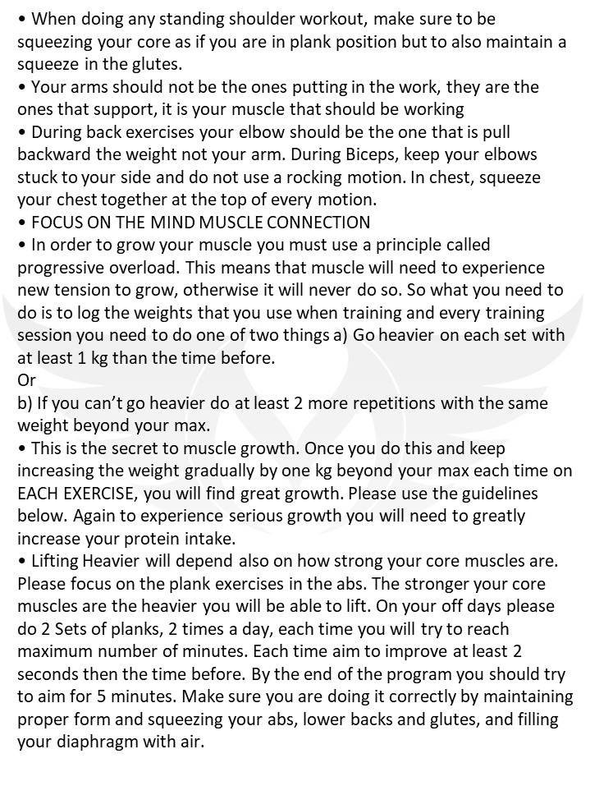

Slide 4
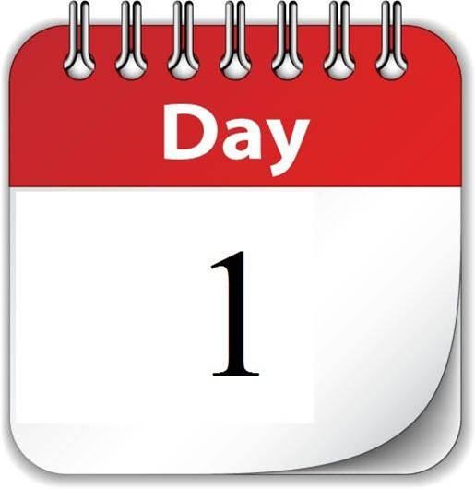

Slide 5
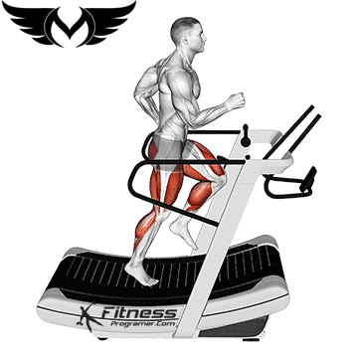
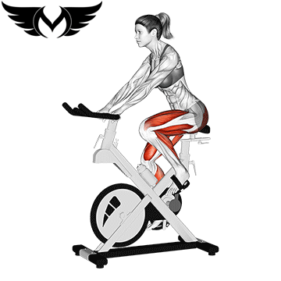
warm up
Choose one
Warm up for 5 : 10 min

Slide 6
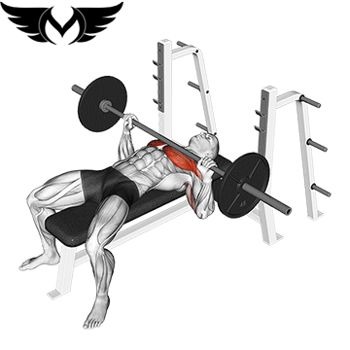
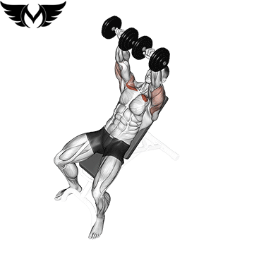
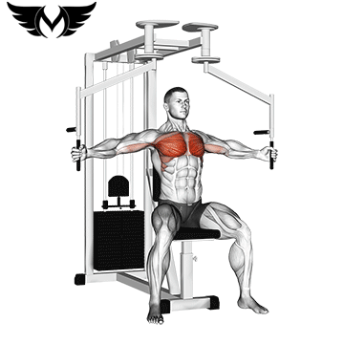
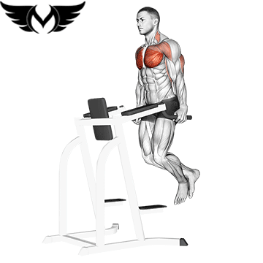
Barbell Bench Press
12
4
Incline-Dumbbell-Press
Rest
45:60 sec
between
each
set
12
3
Chest FLY Machine
Dips
3
Super set
12

Slide 7
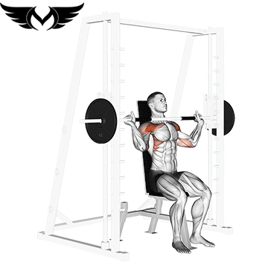
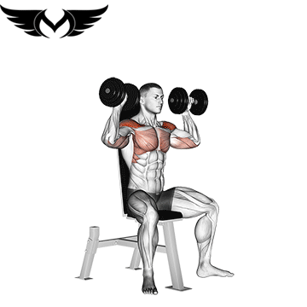
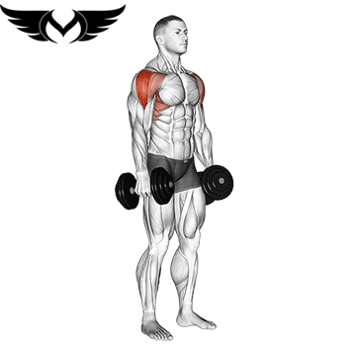
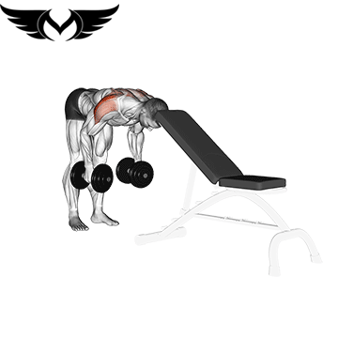
Overhead Press
12
4
Dumbbell Shoulder Press
Rest
45:60 sec
between
each
set
12
3
Dumbbell Lateral Raise
Bent over dm
3 sets
Super set
12 reps

Slide 8
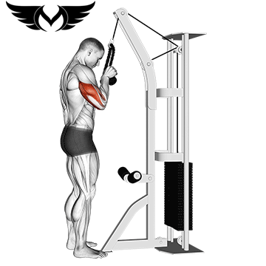
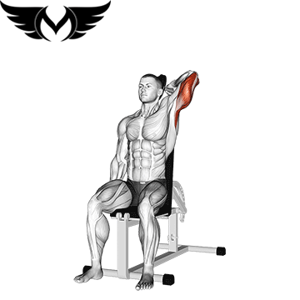
Rope-Pushdown
12
3
Rest
45:60 sec
between
each
set
One Arm Dumbbell Triceps
12
3

Slide 9
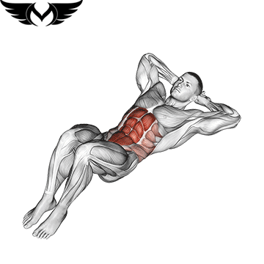
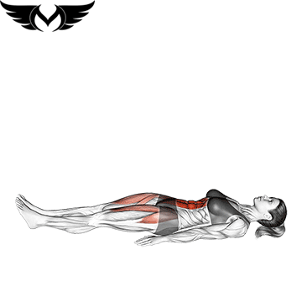
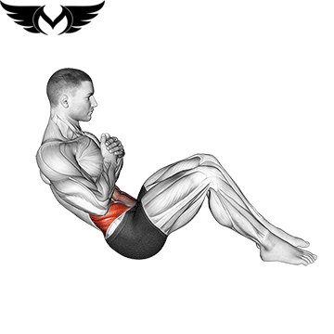
Crunches
15
3
Leg raise
Rest
45:60 sec
between
each
set
15
3
Russian-Twist
12
3

Slide 10
Cardio 25 : 40 min

Slide 11
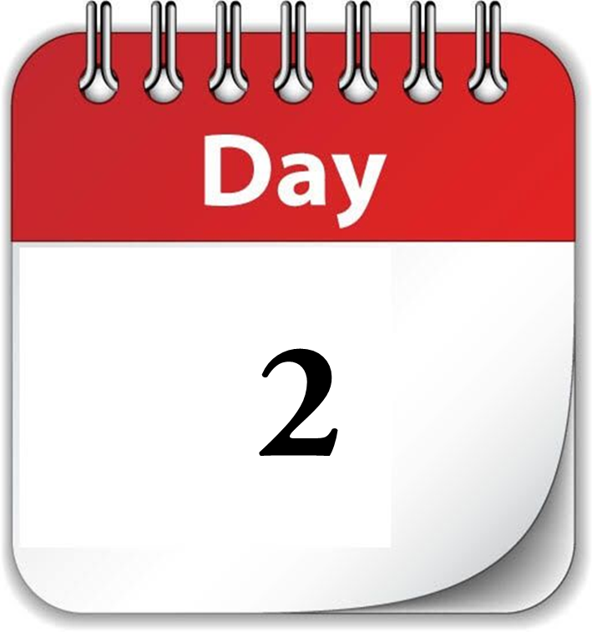

Slide 12
warm up
Choose one
Warm up for 5 : 10 min

Slide 13
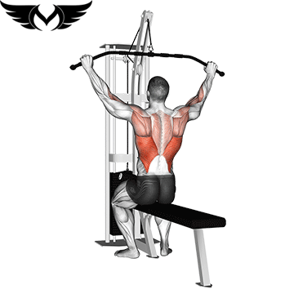
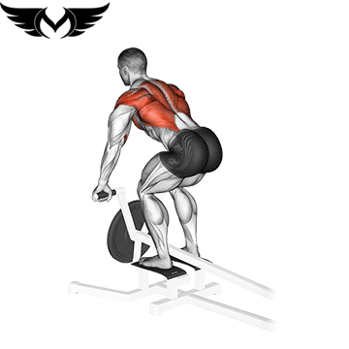
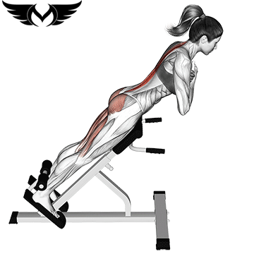
lat Pull down
12
4
Rest
45:60 sec
between
each
set
T_bar Row
12
4
Back Extension
15
4

Slide 14
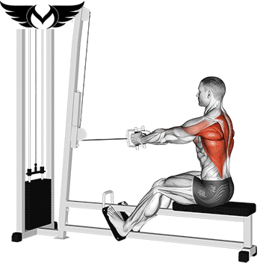
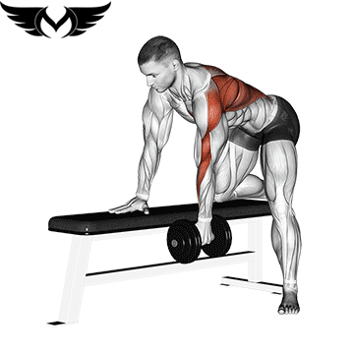
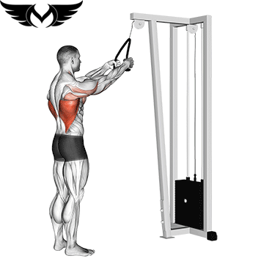
close-grip-cable-row
12
4
Dumbbell-Row
Rest
45:60 sec
between
each
set
12
4
Cable-Straight-Arm-Pulldown
12
4

Slide 15
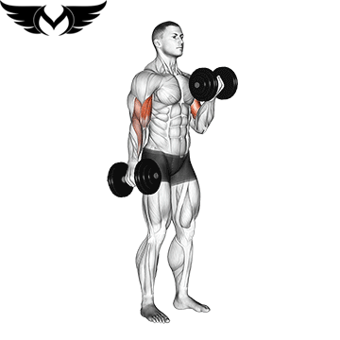
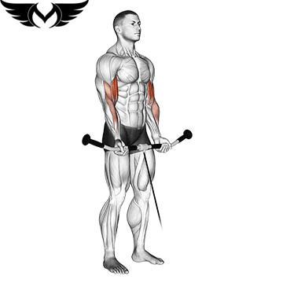
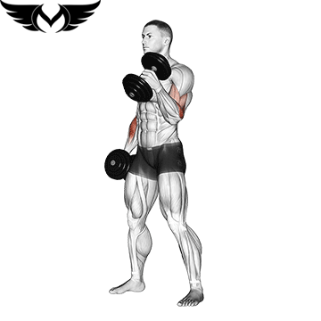
Dumbbell Curls
10
4
cable-curl
Rest
45:60 sec
between
each
set
12
4
Dumbbell hummer
12
4

Slide 16
Cardio 25 : 40 min

Slide 17
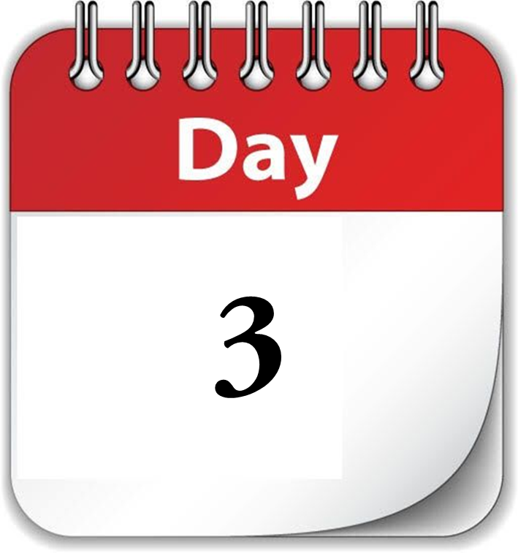

Slide 18
warm up
Choose one
Warm up for 5 : 10 min

Slide 19
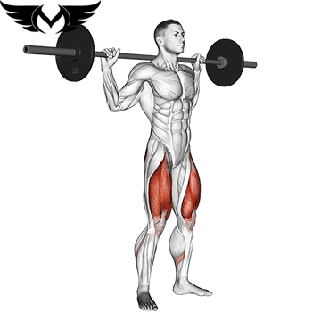
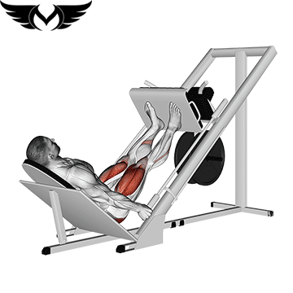
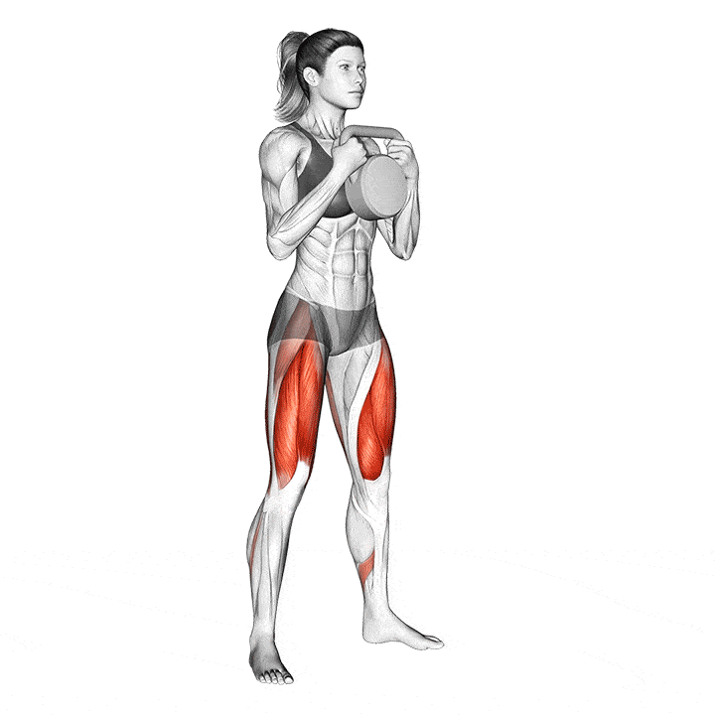
Barbell squat
12
4
Leg Press
Rest
45:60 sec
between
each
set
12
4
Dumbbell Front Squat
12
4

Slide 20
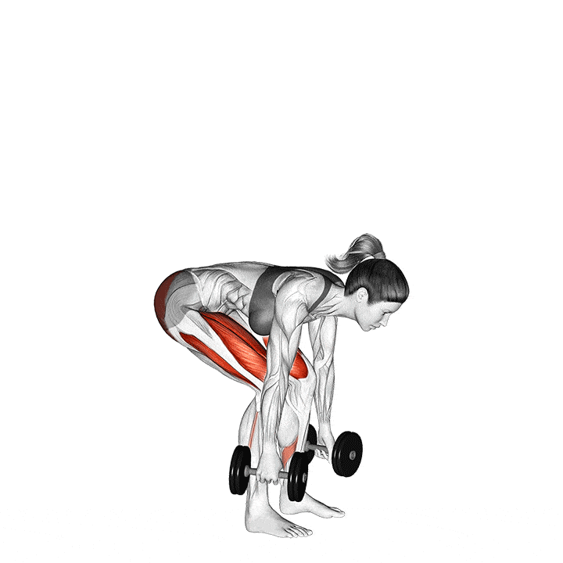
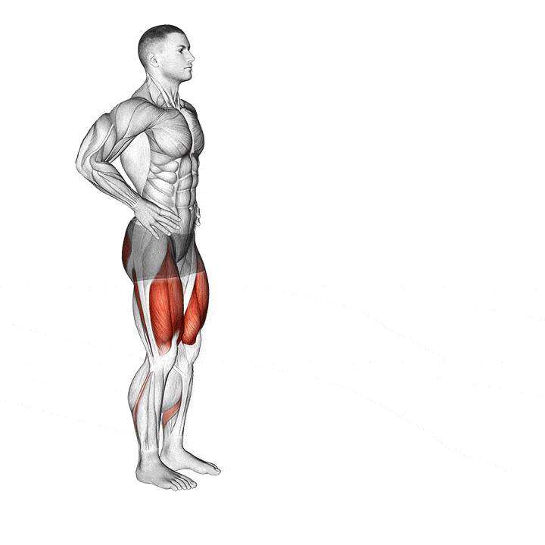
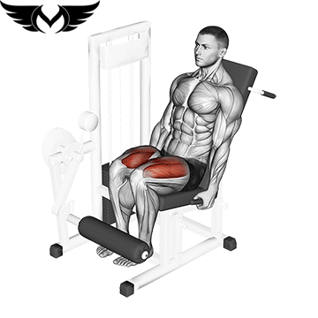
Deadlift
8
4
Rest
45:60 sec
between
each
set
Lunges
12
4
LEG-EXTENSION
15
3

Slide 21
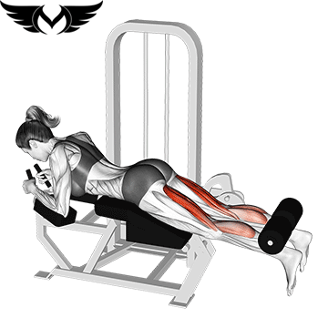
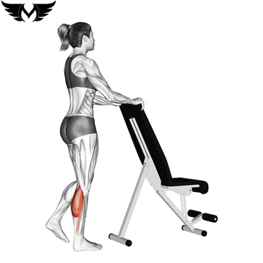
Leg curl
15
3
calves
Rest
45:60 sec
between
each
set
15
3
ABS
Leg Raises
15
3

Slide 22
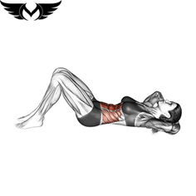
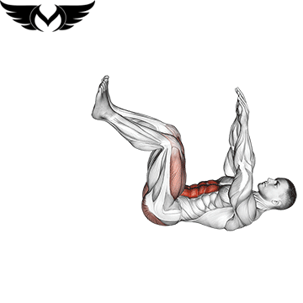
Crunches
15
3
Spider-Plank
Rest
45:60 sec
between
each
set
15
3
Knee Crunch
12
3

Slide 23
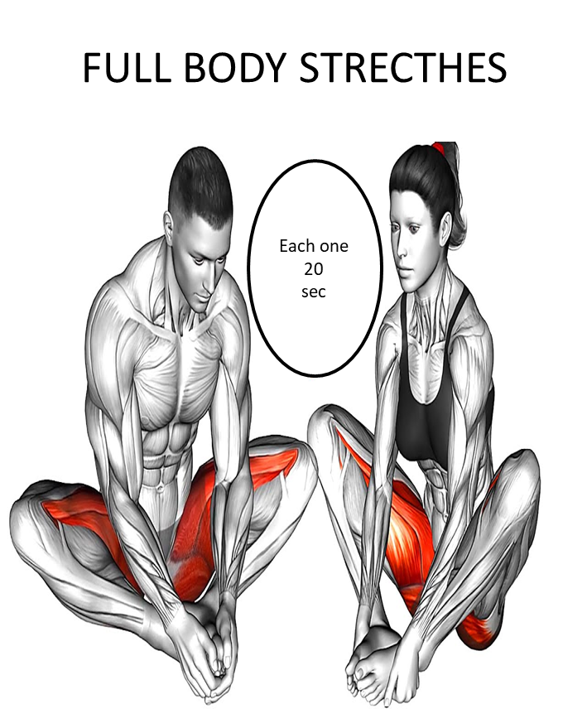

Slide 24
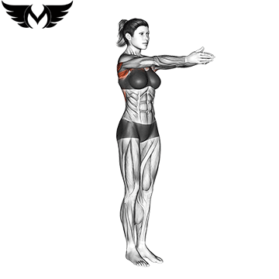
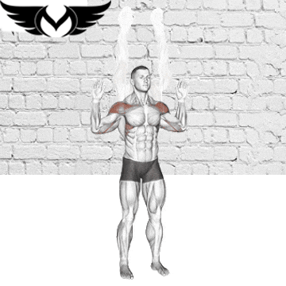
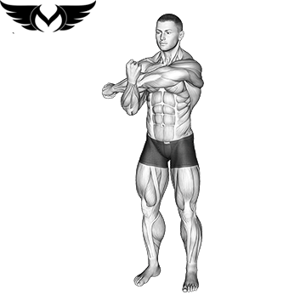
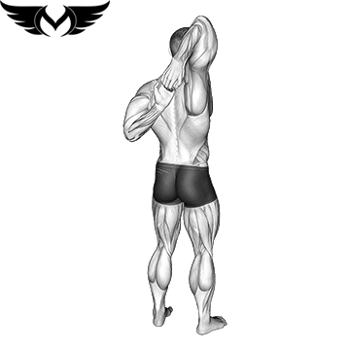
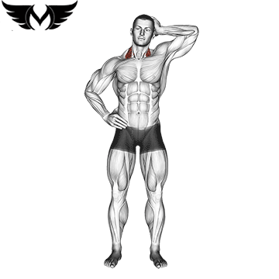
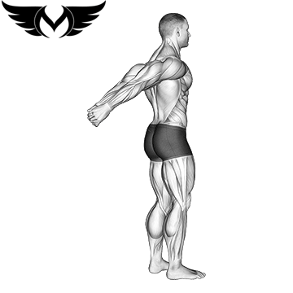
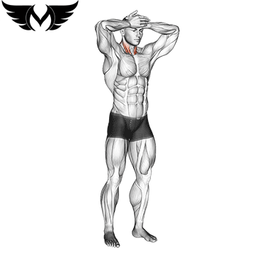
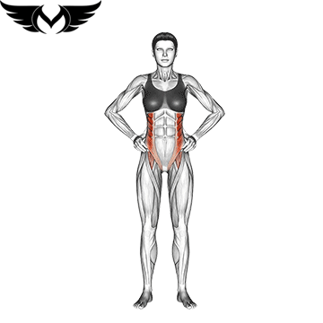
Full body stretches
Upper body stretches
2 SETS
15:20 sec

Slide 25
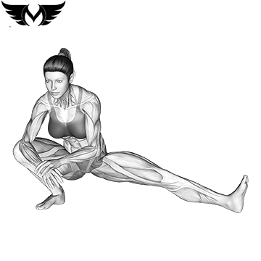
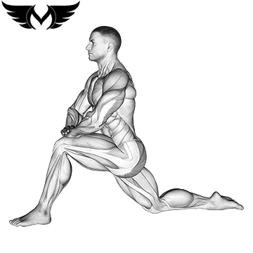
lower body stretches

Slide 26
lower body stretches

